Slide 1
Form 1099-MISC
Pub 4012 – Tab D
Note NTTC-modified 4012 added notes
Notes:
This presentation is provided because the TaxSlayer software does not always provide options for properly reporting income received on a 1099-MISC. This presentation can be used to refresh the knowledge of returning volunteers. For new volunteers, it is recommended that this lesson be used to reinforce the training following lessons on Business Income (Self-Employment), Royalties, and Other Income.
The following examples illustrate this TaxSlayer issue:
When royalties are reported on a 1099-MISC, the taxpayer must be interviewed to determine the source of the royalties. Gas and Oil royalties are reported using Schedule E while royalties from a taxpayer’s own work product such as a song or a book are reported as business income on Schedule C. When the income is entered in the “Royalties” block on the TaxSlayer 1099-MISC input screen, the only option provided is schedule E.
When “non-employee compensation” is reported on a 1099-MISC, the taxpayer must be interviewed to determine whether the income is truly self-employment income. If it is self-employment it is reported on Schedule C. However, in some cases it will be determined that the taxpayer was not in a “business” situation and the income should be reported as other income on line 21 of the Form 1040. TaxSlayer only provides one option for non-employee compensation: Schedule C
Conversely, when “other income” is reported on a 1099-MISC, the interview may determine that it is actually self-employment income. However, if the income is entered in the “other income” box, TaxSlayer automatically sends it to line 21.
This presentation provides information approved by the IRS for entering income reported on a 1099-MISC so that it will be reported properly on the return

Slide 2
Lesson Topics
Form 1099-MISC
Box 2 Royalties
Box 3 Other income
Box 6 Medical and health care payments
Box 7 Nonemployee compensation
TaxSlayer entry

Slide 3
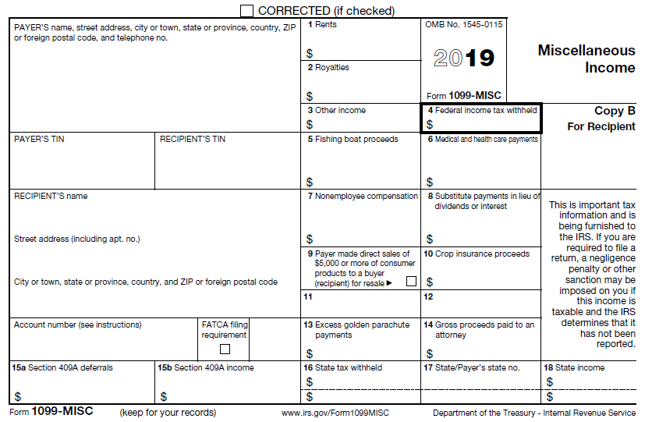
Form 1099-MISC
Notes:
Highlighted fields are the ones we normally deal with

Slide 4
Review Form 1099-MISC with Taxpayer
Ask probing questions to determine source of income
Royalties: oil, gas, writers, singers, etc.
Non-employee compensation
Other income: jury duty, poll worker, medical study, prizes, gambling, etc.
Medicaid waiver or care giver income (Box 6) - Rare
Notes:
Medicaid waiver information in slide deck 24

Slide 5
Include Every Form 1099-MISC in TaxSlayer
Enter each Form 1099-MISC individually in TaxSlayer
May require reporting income on different line in TaxSlayer
Even if not the box shown on Form 1099-MISC
Exception to the rule – Use caution
Verify income reported correctly on return when changing placement of Form 1099-MISC income
Notes:
IRS SPEC guidance varies from the traditional practice to “Key What You See”

Slide 6
Box 2 – Royalty Examples
Examples of Income | Direct to:
Royalties for oil and gas – enter as Royalties | Box 2 | Schedule E
Royalties that are a result of self-employment, e.g., writers, singers, etc. – enter as Nonemployee compensation | Box 7 | Schedule C
Notes:
If the taxpayer was in the business of writing, singing, inventing etc., then royalties for that work go on Schedule C. If the royalties are for something they are no longer in the business but being paid for something that the taxpayer produced such as a song, book, invention, etc. then it is the result of work that they performed (i.e. self-employment) so per Pub 17, it is reported on Sch C
See NTTC Training Slide Set #19 Income Rent and Royalty for more information

Slide 7
Box 3 – Other Income Examples
Examples of Income | Direct to:
Other Income that isn’t reported elsewhere such as prizes or awards – enter as Other income | Box 3 | Line 21
Other Income that is really self-employment income – enter as Nonemployee compensation | Box 7 | Schedule C
Notes:
Some businesses and non-profits (e.g. Churches) will report income in box 3 as other income even though the taxpayer performed substantial work or services during the year (e.g. Choir Director, janitor, etc.).

Slide 8
Box 6 – Medical and Health Care Payments Example
Example of Income | Direct to:
Medicaid Waiver Payment – enter as Other income* | Box 3 | Line 21
Other Box 6 Income – out of scope
* Also make offsetting entry on Line 21 to subtract income
Notes:
Sometimes a payer will incorrectly report income in Box 6 such as Medicaid Waiver Payments or payments for participation in a medical study or trial See NTTC Training Slide Set #24 Income Other – Medicaid Waiver for more information

Slide 9
Box 7 – Non-Employee Compensation Examples
Examples of Income | Direct to:
Non-Employee Compensation that is not really a business such as an honorarium for a speech where there is no continuing relationship and no expectation of ever doing it again | Box 3 | Line 21
Non-Employee Compensation that is normally a business | Box 7 | Schedule C
Notes:
A thorough interview is required to determine if the taxpayer was actually engaged in a business
See NTTC Training Slide Set #15 Income Business for more information

Slide 10
Form 1099-MISC Scope
Form 1099-MISC in scope except for:
Box 5 Fishing boat proceeds
Box 6 Medical and Health Care Payments
Other than care giver income—but don’t enter in Box 6
Boxes 8-15
Box FATCA filing requirement
Notes:
TaxSlayer will not accept an entry in Box 6. Use Box 3 for Medicaid Waiver payments, Box 7 for other caregiver payments

Slide 11
Summary of TaxSlayer 1099-MISC
Pub 4012 Tab D
Verify every Form 1099-MISC entered on tax return
Confirm probing interview used to properly classify Form 1099-MISC income
Verify Form 1099-MISC income reported correctly on tax return
Income may be reported on different line than shown on Form 1099-MISC

Slide 12
Form 1099-MISC
Comments?
Questions?

